Slide 1
Digital Image Correlation (DIC)
Egil Fagerholt

Slide 2
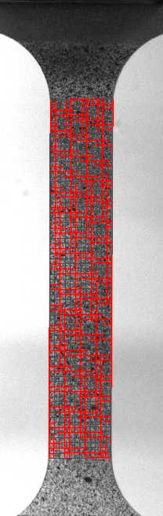
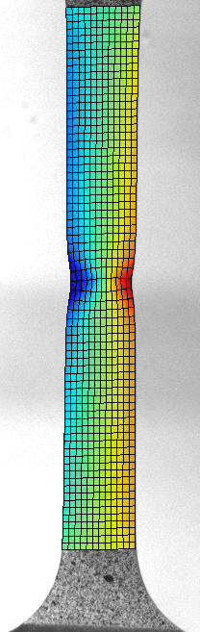
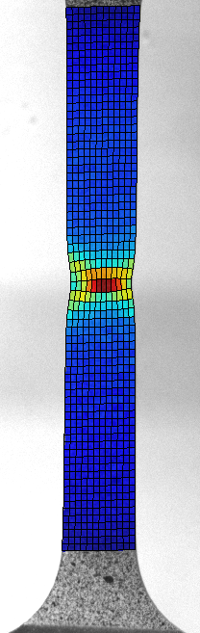
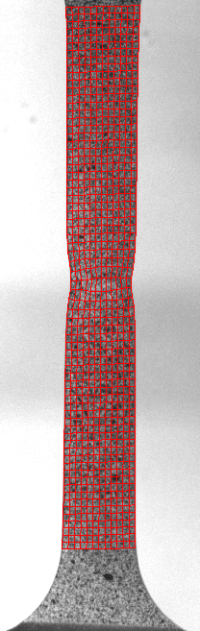
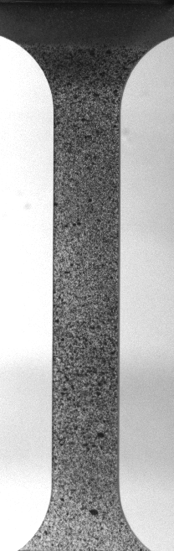
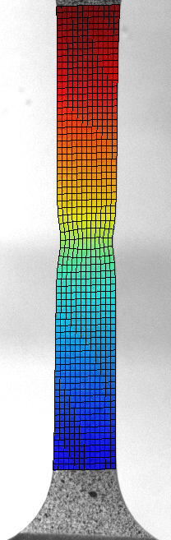
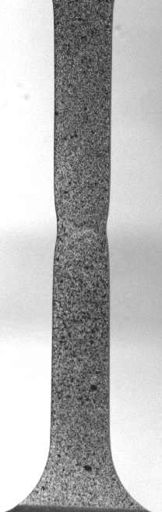
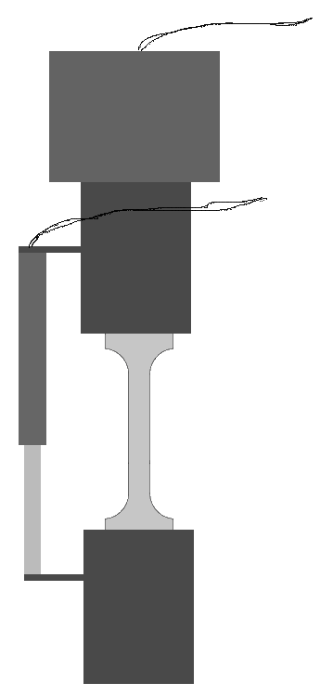
DIC – Basic Principle
Example: Uniaxial tension test
Load cell
Random speckle pattern
Linear transducer
DIC
Camera
Optical axis normal to specimen surface (2D-DIC)
Disp. Y
Disp. X
Strain
Reference image
No deformation
Current image
At deformed stage

Slide 3
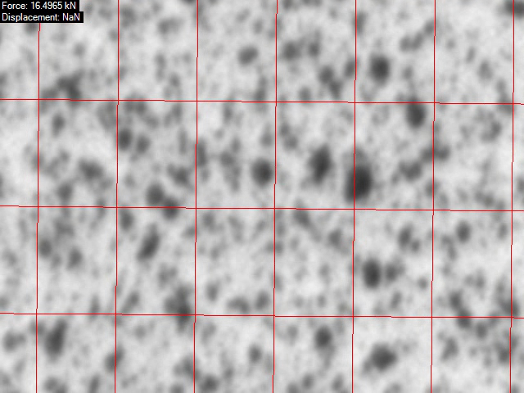
DIC – Tracking of grayscale pattern

Slide 4


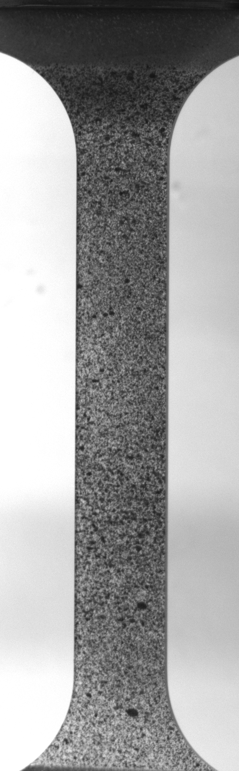
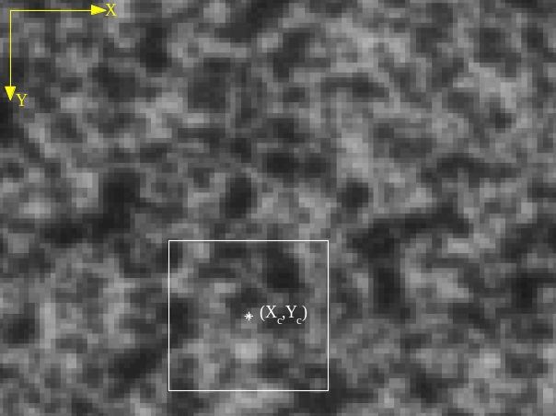
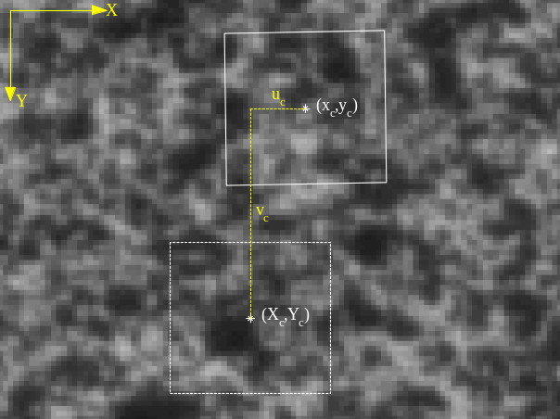





DIC – Material point tracking (Subset-based formulation)
Reference image
Current image
Subset
Deformation parameters (linear subset):
Reference configuration position vector:
Displacement vector:
Function to minimize (SSD):
Current configuration position vector:
[4] Sutton MA, McNeill SR, Helm JD, Chao YJ (2000) Advances in two-dimensional and three-dimensional computer vision

Slide 5

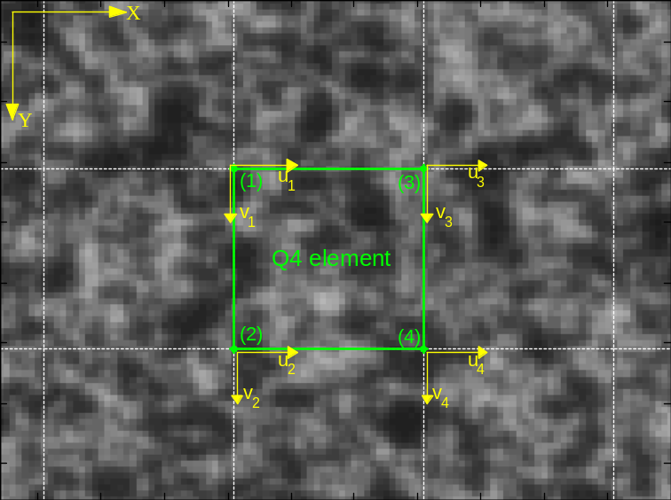



DIC – Global «finite element» formulation
Function to minimize (SSD):
Decomposing to finite elements
”Stiffness matrix”
Weighted sum of grayscale
gradients.
”Load vector”
Weighted sum of grayscale
differences and gradients.
Assembly of element contributions
Global equation
Nodal degrees of freedom increment
Iterated until a correlation criteria is fulfilled
[5] Besnard G, Hild F, Roux S (2006) “Finie-element” displacement fields analysis from digital images: application to Portevin-Le Chatelier bands

Slide 6
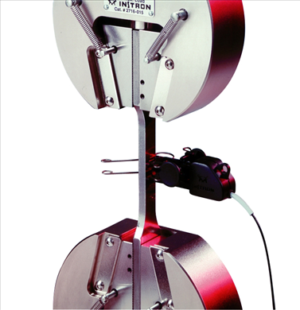
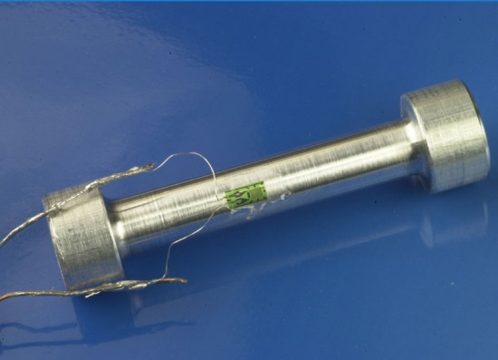
DIC versus traditional measurement techniques
Extensometer
Strain gauges
DIC
Elongation over a
fixed distance
Strain in a small area
Displacement and strain fields are measured
over the specimen as viewed by the camera
Elongations can be extracted during
post-processing

Slide 7
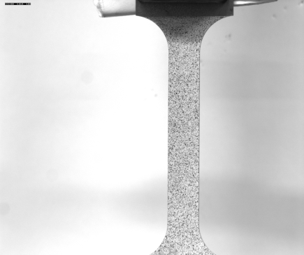
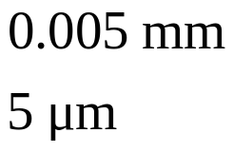

DIC – Measurement uncertainty
Measurement uncertainties are mainly due to grayscale noise in the recorded images,
which varies from camera to camera.
Typical resolution in displacements are less than: 0.1 pixel
Example: Uniaxial tension test
5MP (2448 x 2050 pixels)
Specimen length: 200 mm
Specimen width: 12.5 mm
Strain resolution is typically down to
Local strains as high as 200% can be measured (e.g. polymers)

Slide 8
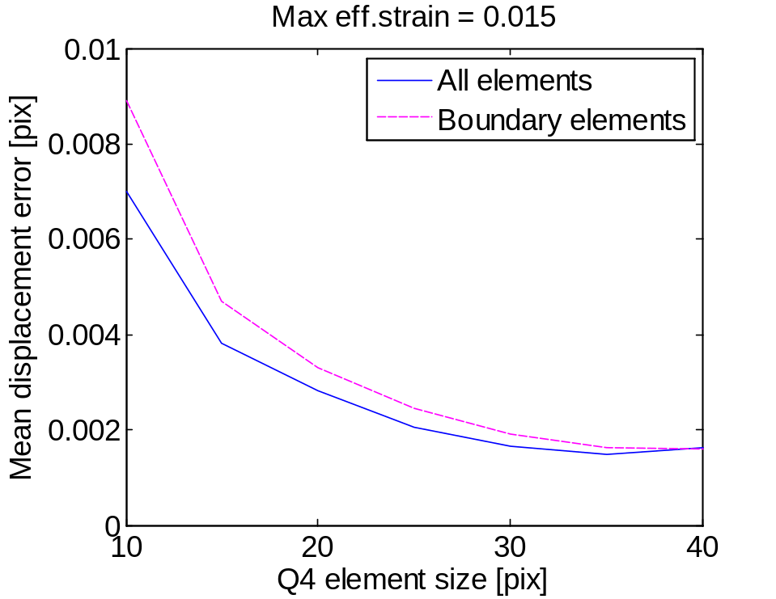
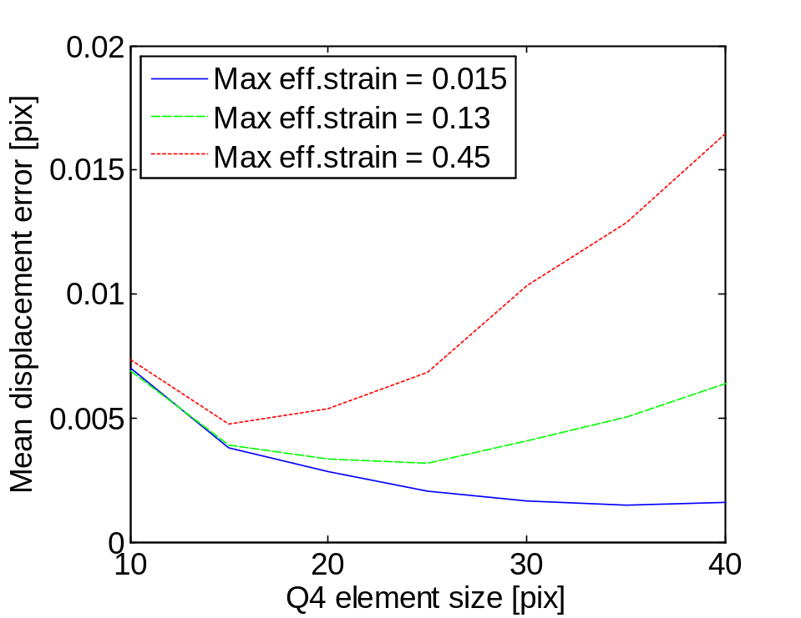
DIC - Measurement uncertainty
Large elements -> Less suceptible to grayscale noise
Small elements -> better description of disp. field
Compromize

Slide 9
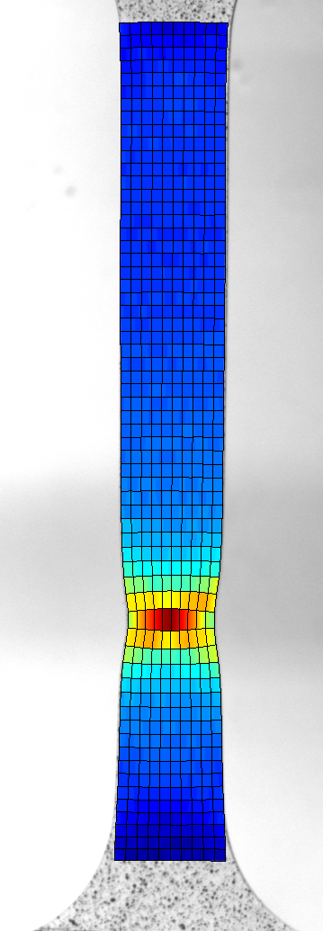
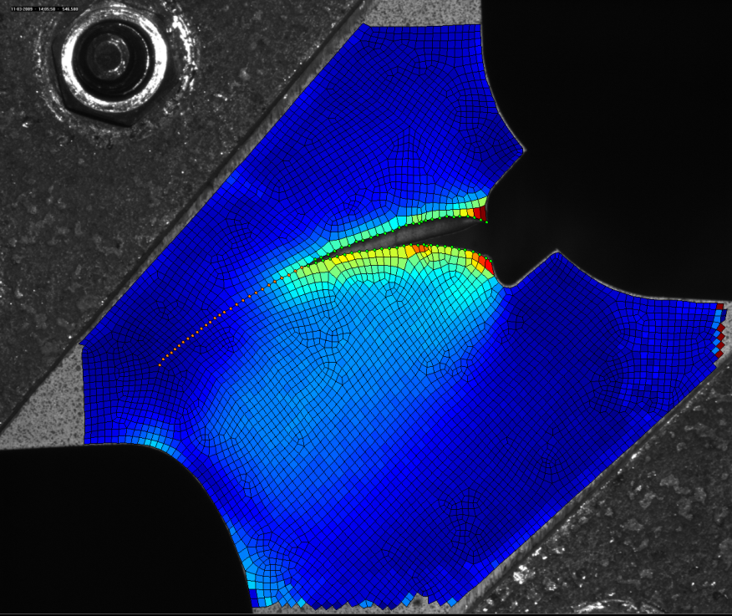
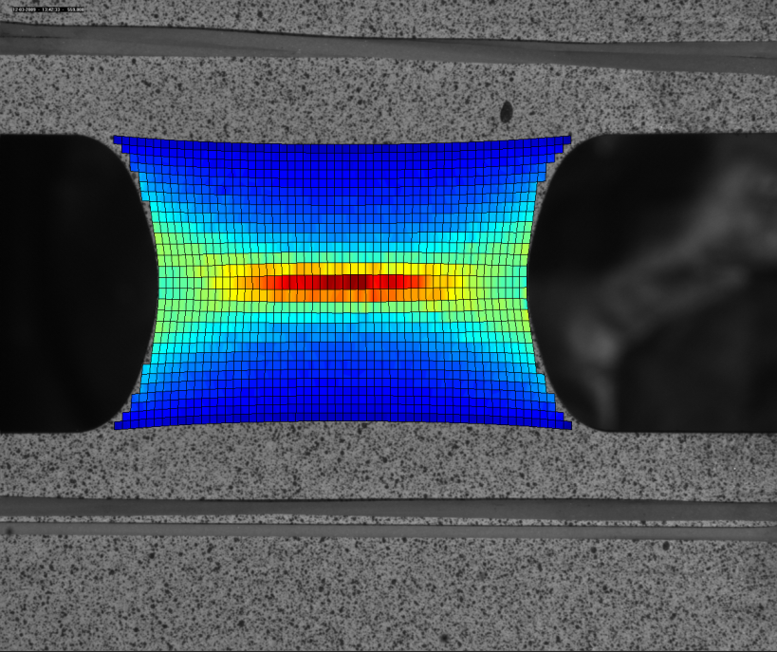
Strain fields from 2D-DIC
- Examples (Docol 600DL)
Uniaxial tension
Plane strain
Arcan-45

Slide 10


DIC – 2D vs. 3D setup
Requirements:
Optical axis normal to
specimen surface
Specimen surface is plane
during experiment
2D
3D
Requirements:
Full camera calibration
Target
coordinates
Benefits:
Specimen may have an
arbitrary shape
Both in-plane and out-of-plane
displacements are measured
Limitations:
Only in-plane displacements
are measured
Benefits:
Simple setup
Limited camera calibration
Single camera
Two cameras
Stereovision
General limitations (both 2D and 3D): No through-thickness deformation is measured

Slide 11
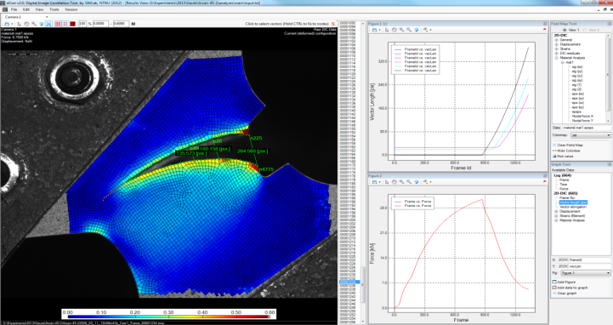
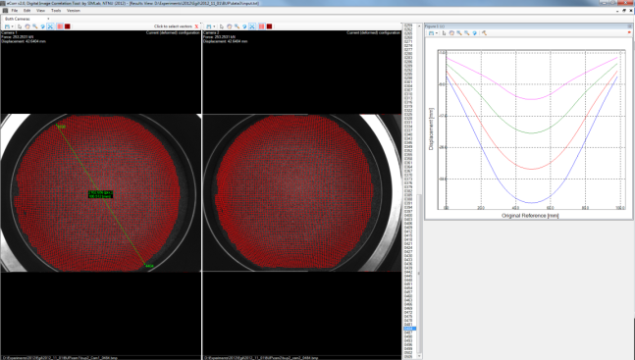
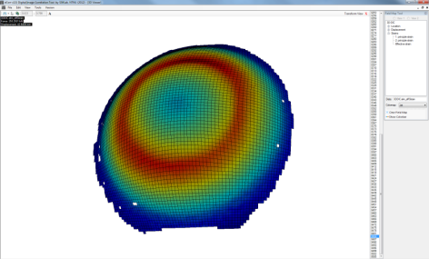
DIC Software
Graphical user interface (GUI)
Record image series
from GigaEthernet cameras
Camera calibration
Mesh generation and
analysis preparation
Run analyses
2D- or 3D-DIC
Study and export results
(displacements and strains)
Data filtering and coupling with
material models

Slide 12
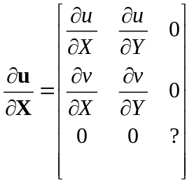
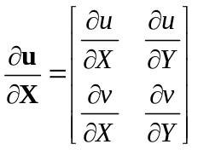







DIC – Strain calculations
Assume no shear strain
through thickness
2D-DIC
Displacement gradient
Assume no
out-of-plane deformation
Deformation gradient
Green deformation
Principal streches (eigenvalues of C)
Principal strain components
Assume negligible elastic strains
and plastic incompressibility
Effective strain based on von Mises norm

Slide 13
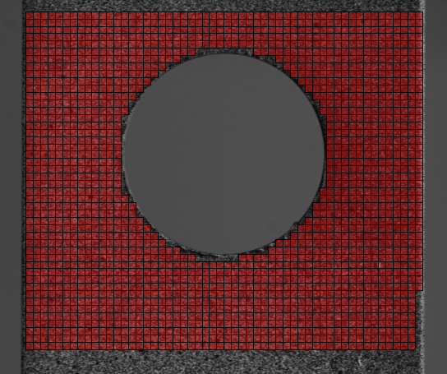
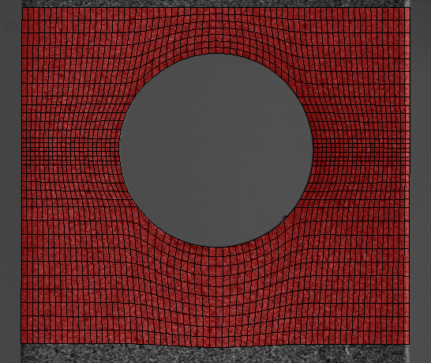
DIC Software – Meshing
Structured mesh
Non-structured mesh
Meshing is done in DIC software GUI
Manually define boundries of specimen
Generate Python script for Abaqus
Use Abaqus meshing tool to generate mesh
Import Abaqus «input-file» in DIC software

Slide 14
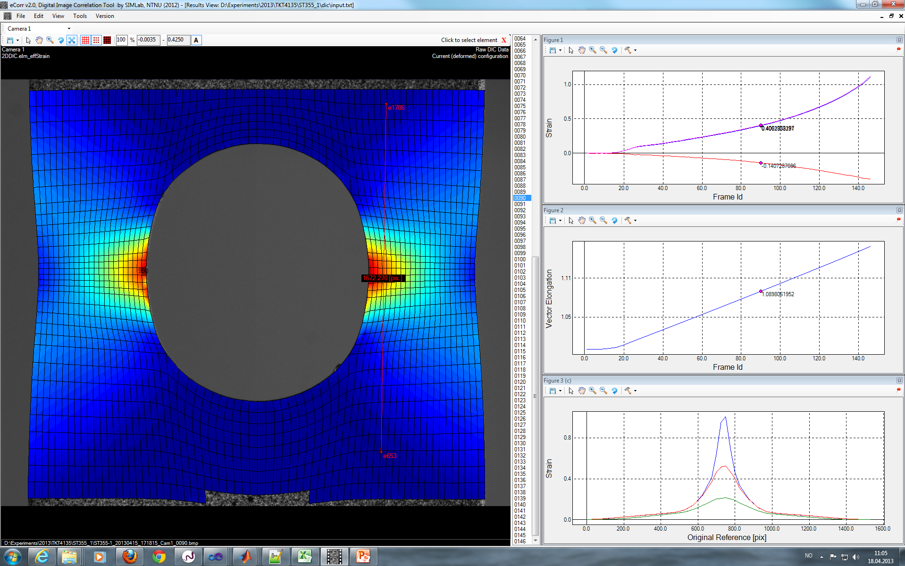
DIC Software – Data Visualization
Principal strain components
Selected vector
Vector elongation
Selected element
Strains through cross section

Slide 15
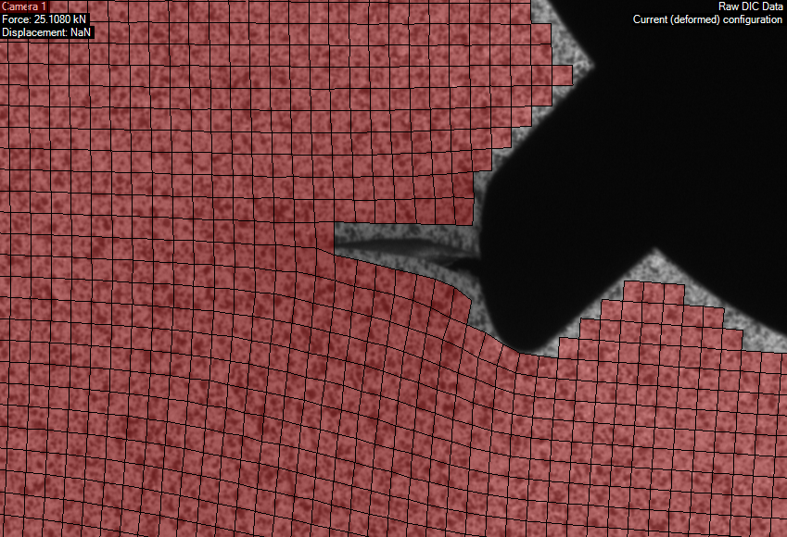
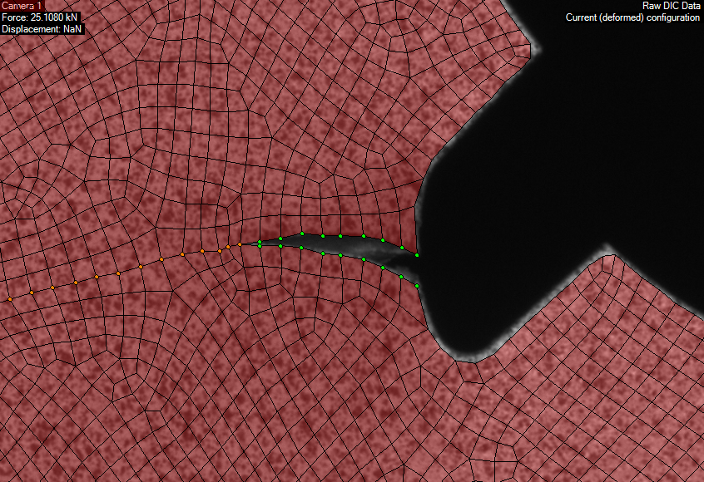
DIC Software – Handling propagating cracks
Element erosion
Node splitting
A discontinuous displcement field is captured
No data lost (eroded)
An initial analysis has to be carried out

Slide 16
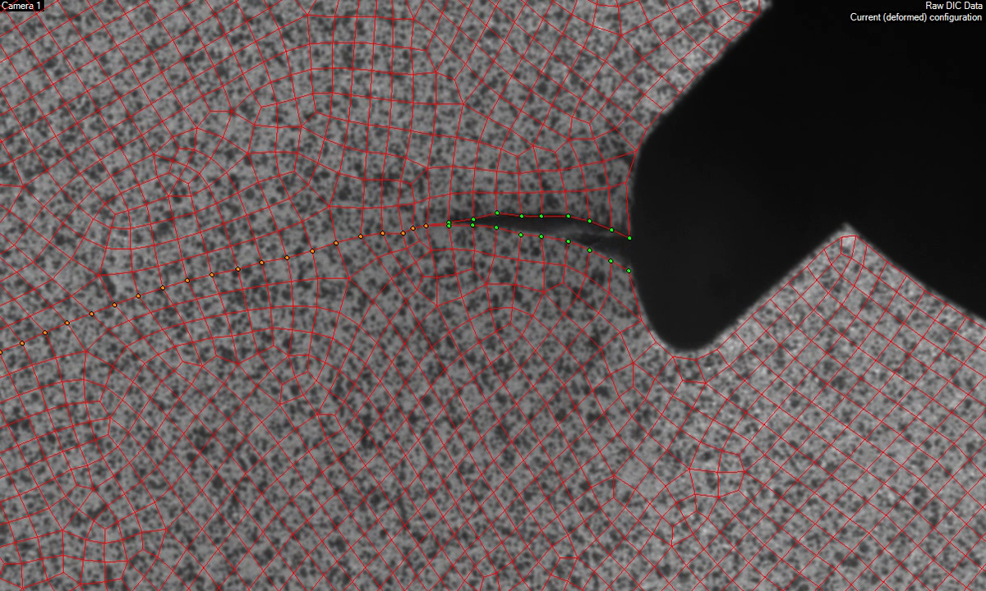
DIC Software – Node splitting

Slide 17
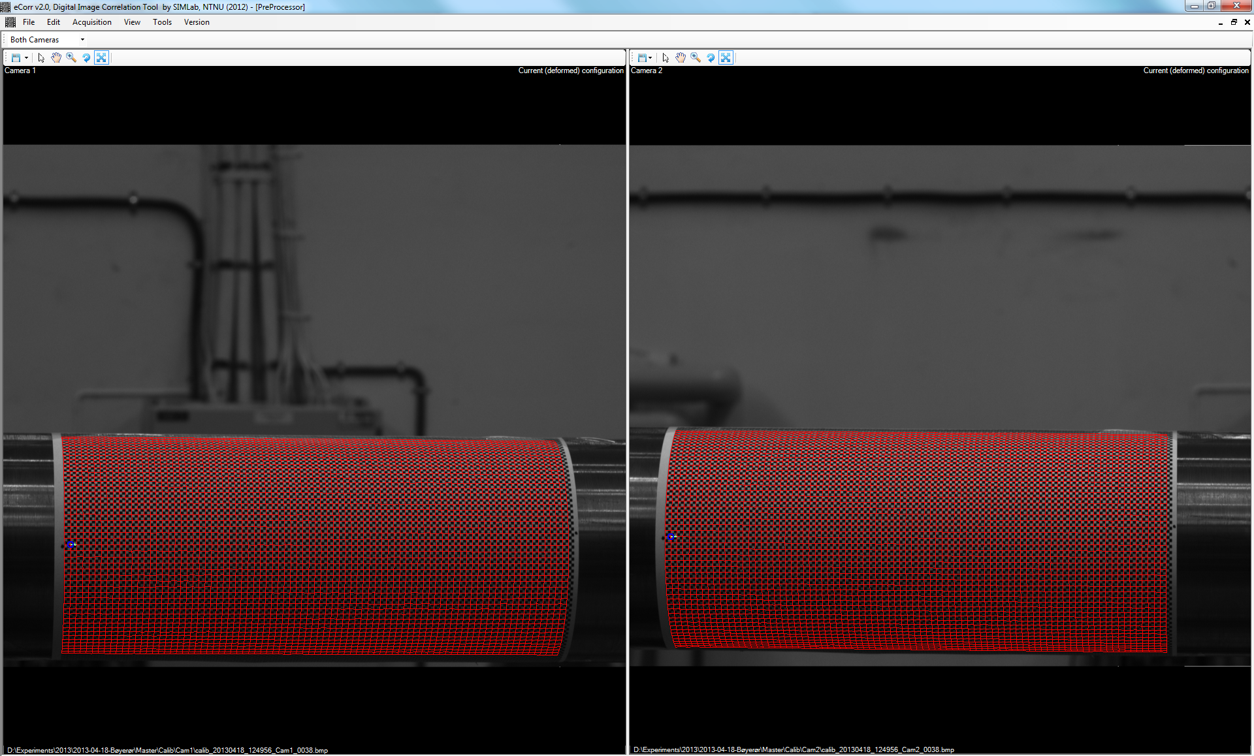
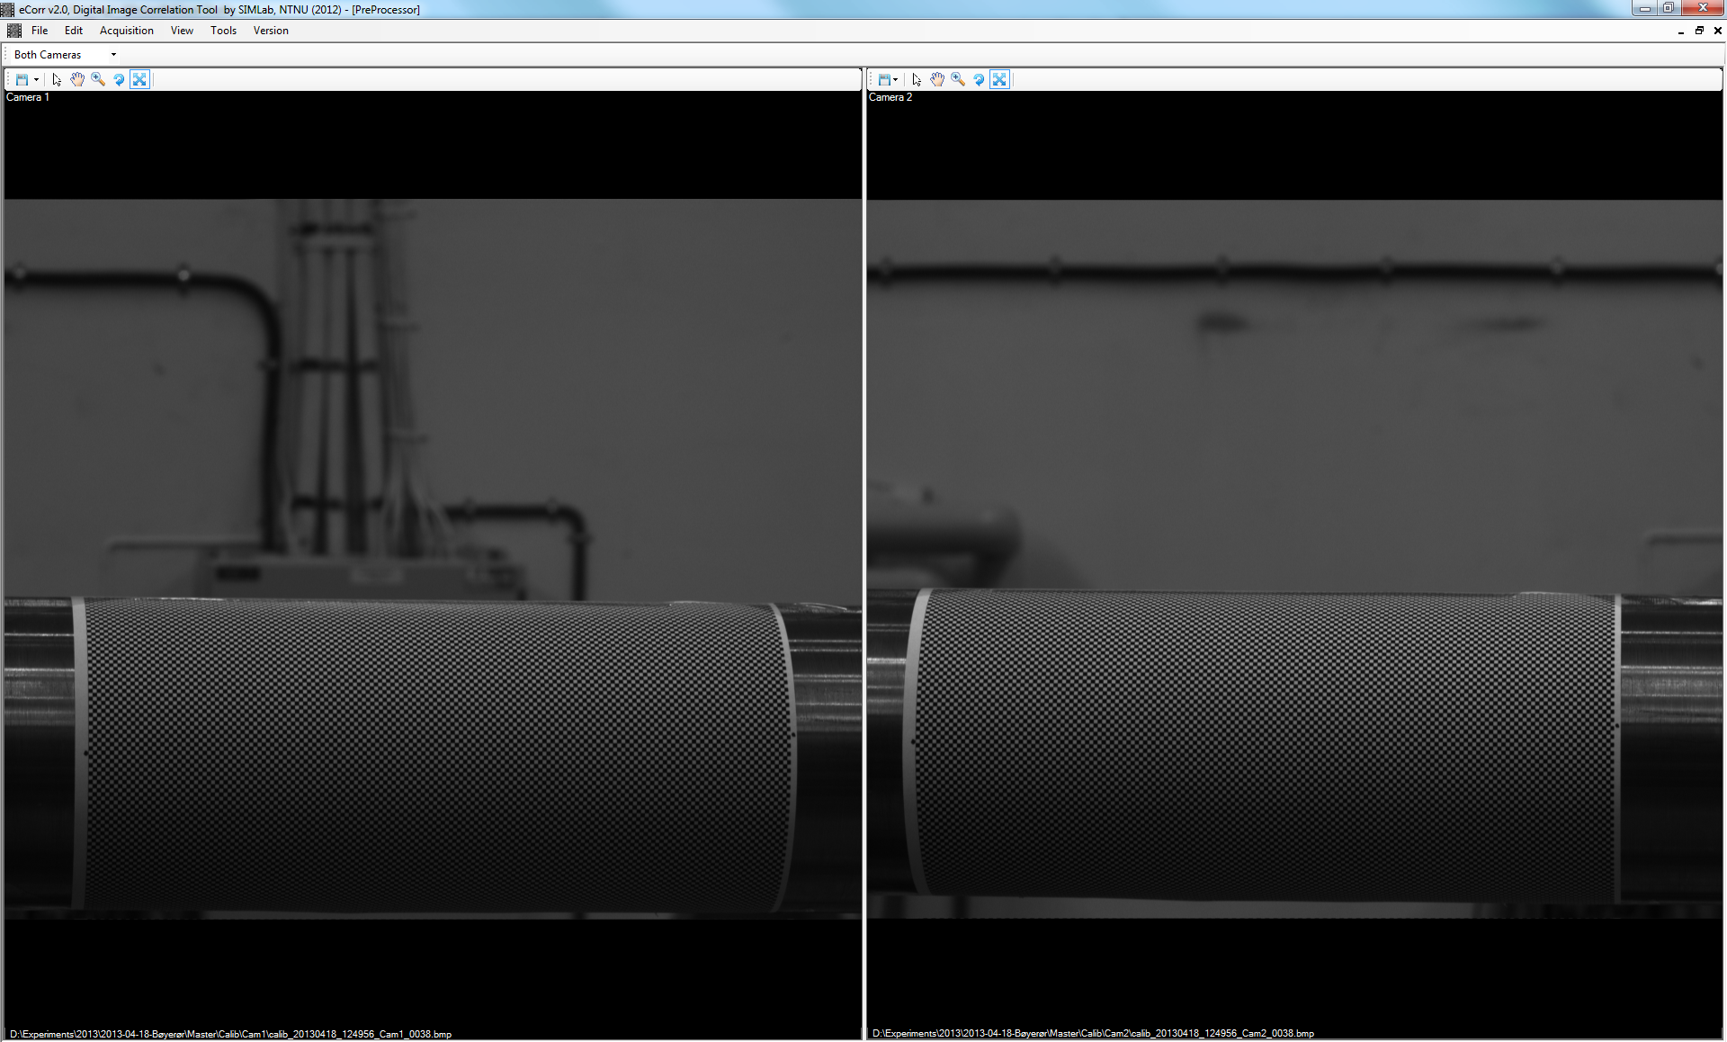

DIC Software – 3D-DIC - Camera calibration
Camera 1
Image coordinates
[pixels]
Target coordinates
[mm]
Camera 2
Image coordinates
[pixels]
Camera model
Camera 1
Camera model
Camera 2
Multiple calibration targets may be used to increase accuracy of camera models

Slide 18
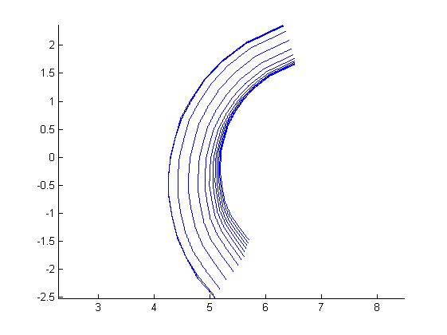
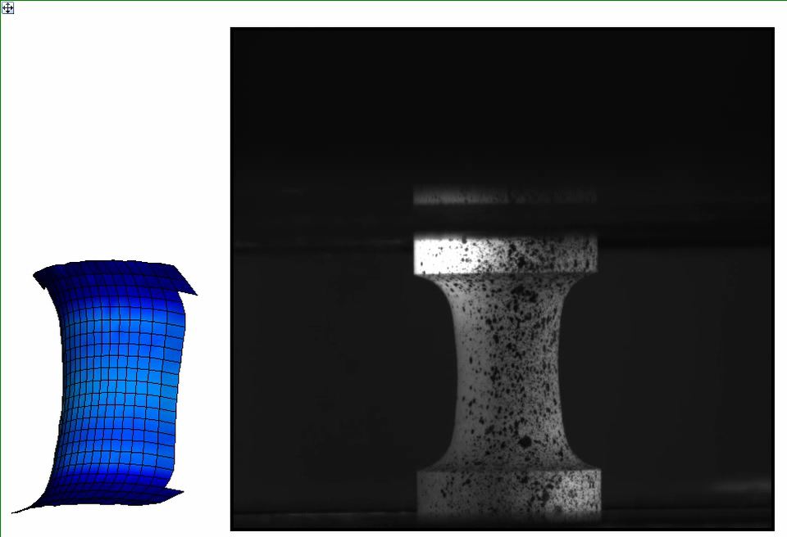
3D-DIC
Specimen cross section
- Uniaxial circular specimen (PVC)

Slide 19
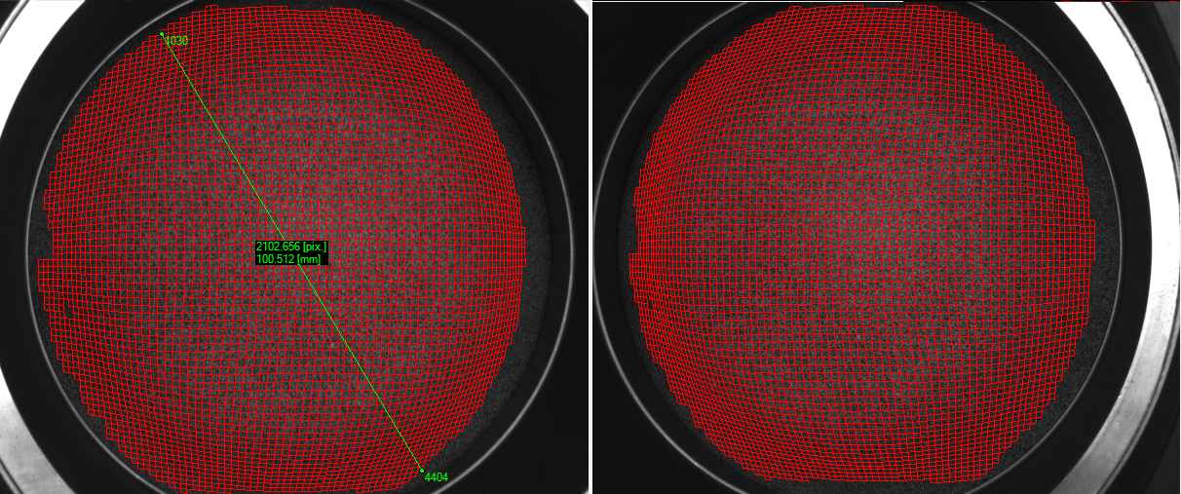
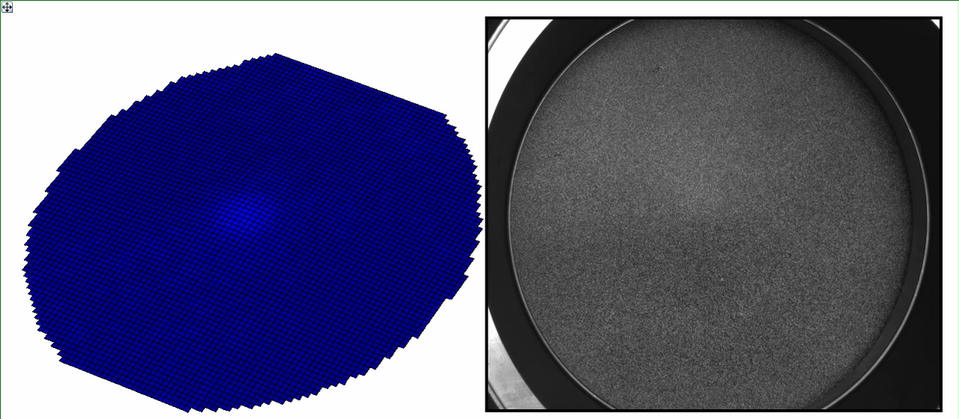
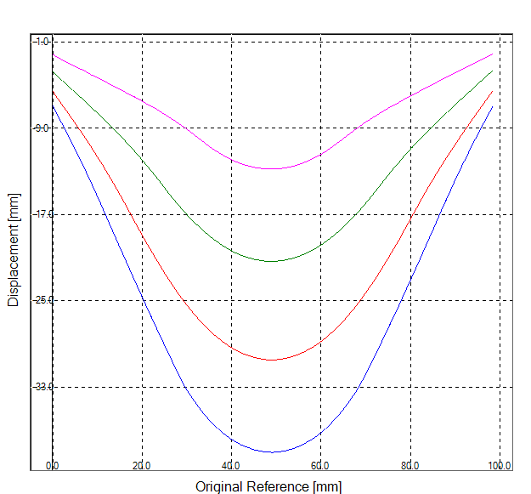
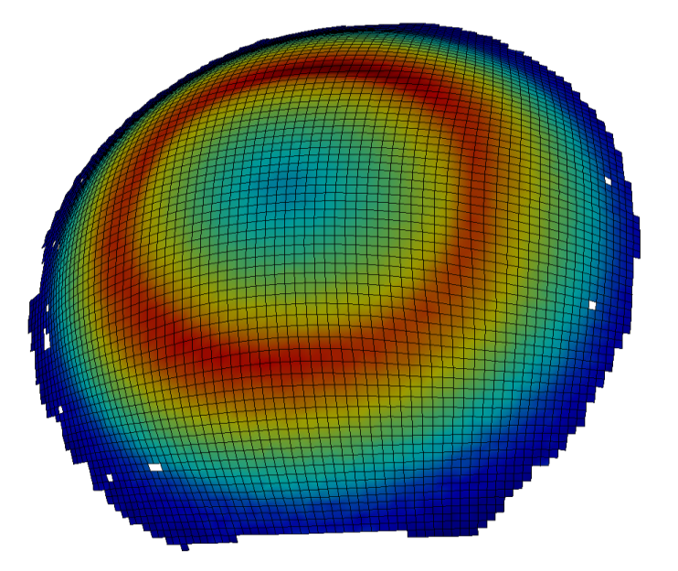

3D-DIC
Camera 1
Camera 2
- Bulge test
Out-of-plane displacement profiles
3D model with strain field

Slide 20
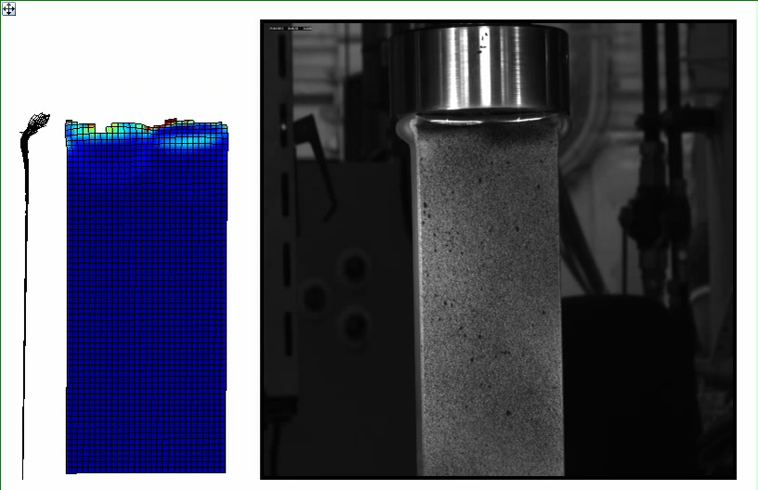
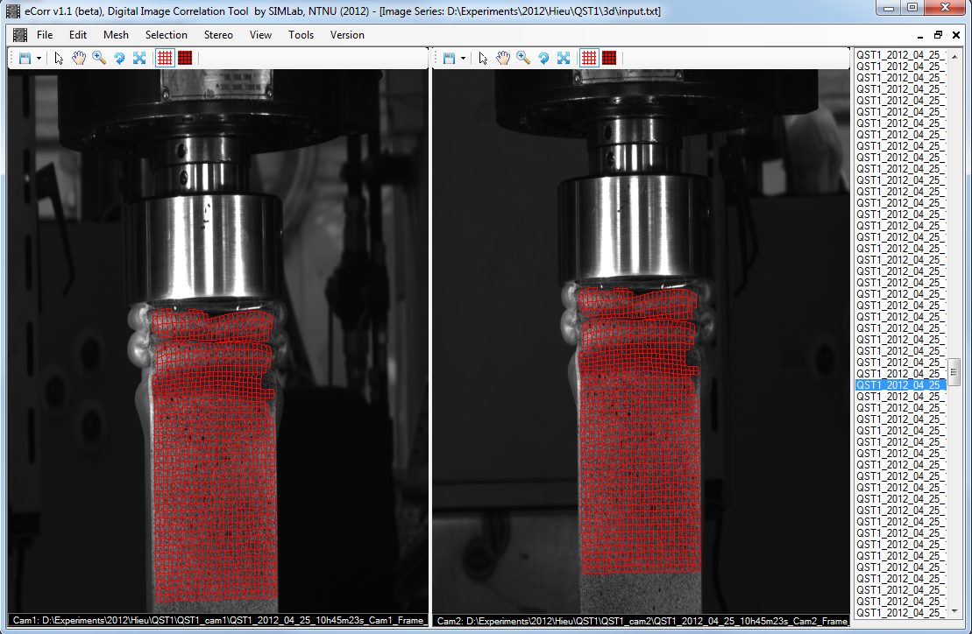
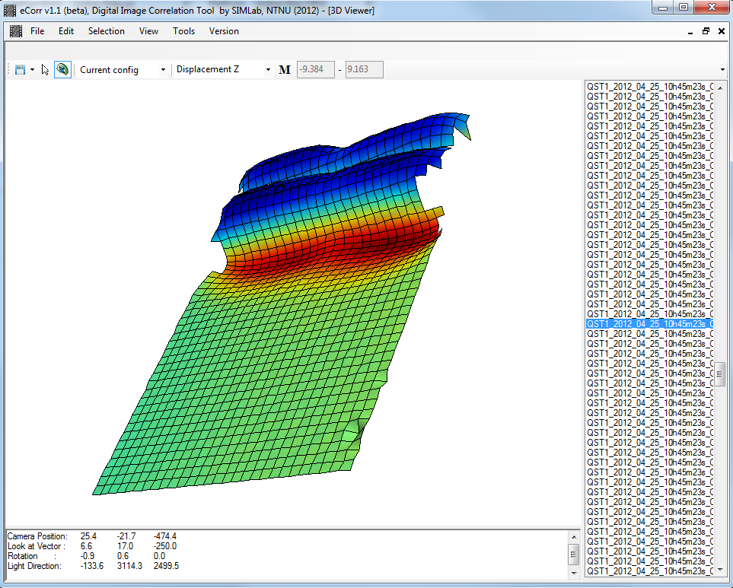
3D-DIC
- Compression of aluminium profiles
3D model

Slide 21
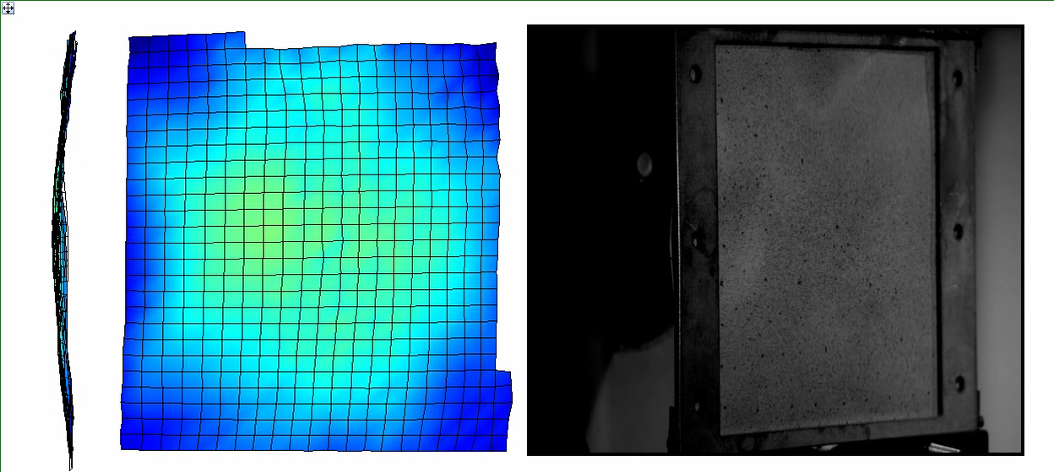
3D-DIC
- Blast loading of aluminium plates (high-speed cameras)
Out-of-plane displacement [mm]

Slide 22
Thank you for listening!

