Slide 1
Digital Image Correlation
Egil Fagerholt
25 August 2015

Slide 2
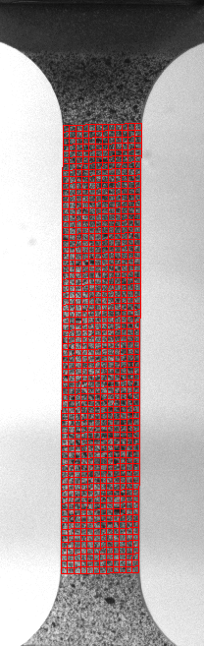
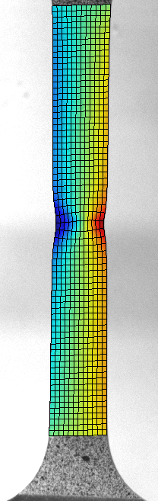
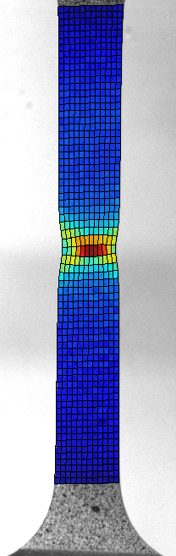
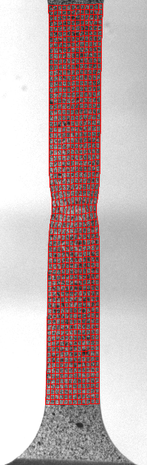
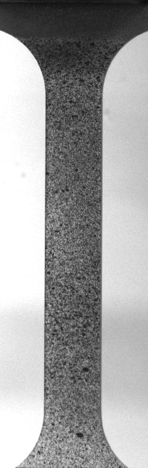
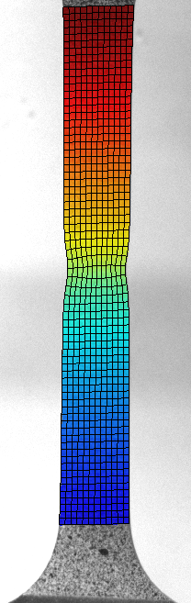
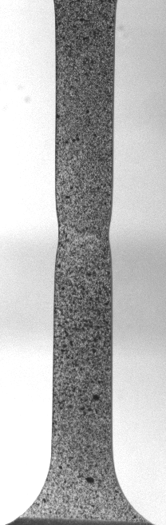
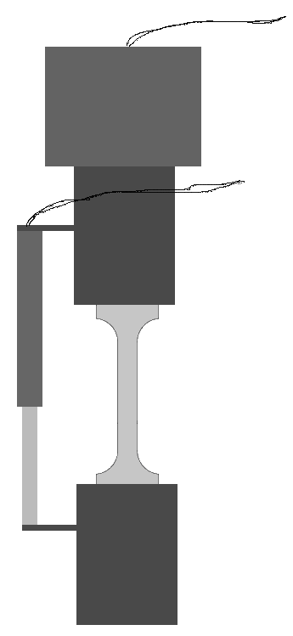
DIC – Basic Principle
Example: Uniaxial tension test
Load cell
Random speckle pattern
Linear transducer
DIC
Camera
Optical axis normal to specimen surface (2D-DIC)
Disp. Y
Disp. X
Strain
Reference image
No deformation
Current image
At deformed stage

Slide 3
DIC – 2D vs. 3D setup
Requirements:
Optical axis normal to
specimen surface
Specimen surface is plane
during experiment
2D
3D
Requirements:
Full camera calibration
Target
coordinates
Benefits:
Specimen may have an
arbitrary shape
Both in-plane and out-of-plane
displacements are measured
Limitations:
Only in-plane displacements
are measured
Benefits:
Simple setup
Limited camera calibration
Single camera
Two cameras
Stereovision
General limitations (both 2D and 3D): No through-thickness deformation is measured

Slide 4
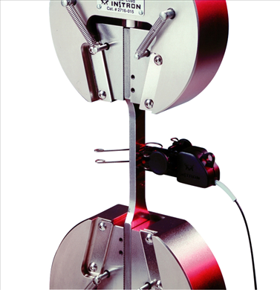
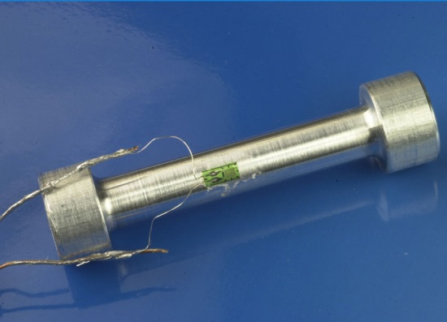
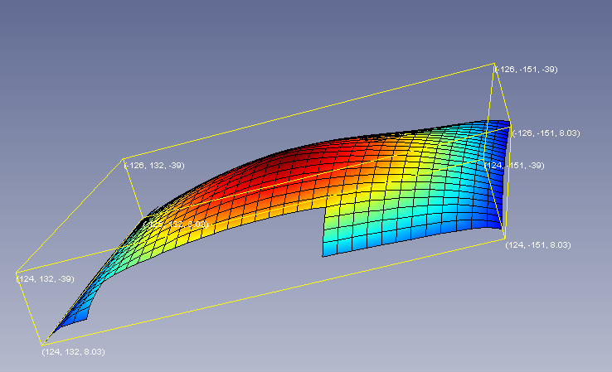
DIC versus traditional measurement techniques
Extensometer
Strain gauges
2D-DIC
Full-field displacement/strain measurements
Elongations extracted during
post-processing
Elongation over a
fixed distance
Strain in a small area
3D-DIC
Laser
Deflection of plate

Slide 5
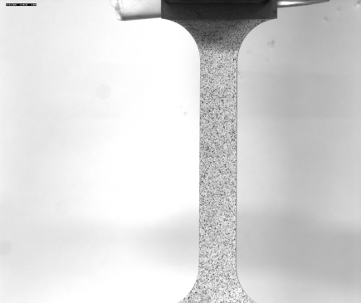
DIC – Measurement uncertainty
Measurement uncertainties are mainly due to grayscale noise in the recorded images,
which varies from camera to camera.
Typical resolution in displacements are less than: 0.1 pixel
Example: Uniaxial tension test
5MP (2448 x 2050 pixels)
Specimen length: 200 mm
Specimen width: 12.5 mm
Strain resolution is typically down to
Local strains as high as 200% can be measured (e.g. polymers)

Slide 6
DIC - Measurement uncertainty
Large elements -> Less suceptible to grayscale noise
Small elements -> better description of disp. field
Compromize

Slide 7
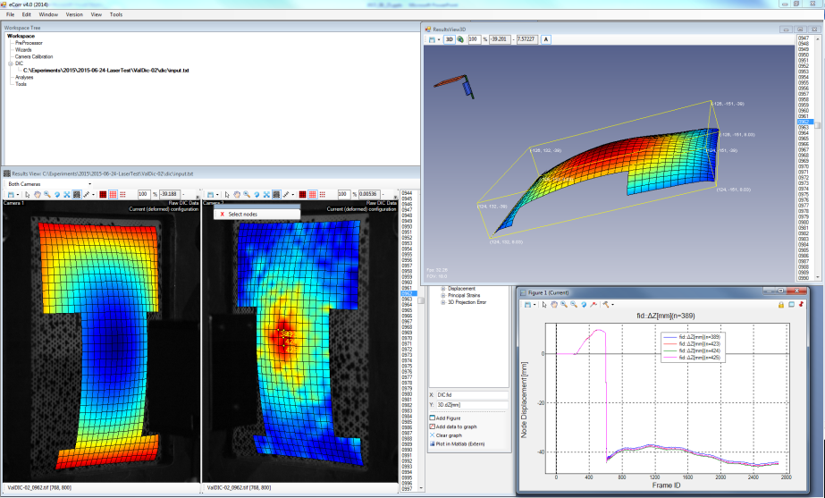
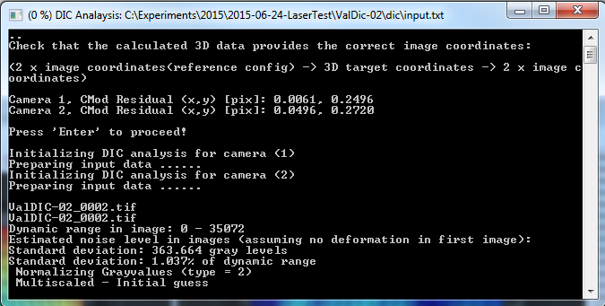
Software eCorr
Main Functionalities
Graphical Interface
Recording of image series
Camera calibration for 3D-DIC
Mesh generation/modification
2D/3D-DIC Analysis
Visualization and export of data
DIC Core

Slide 8

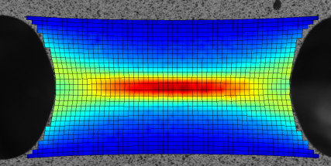
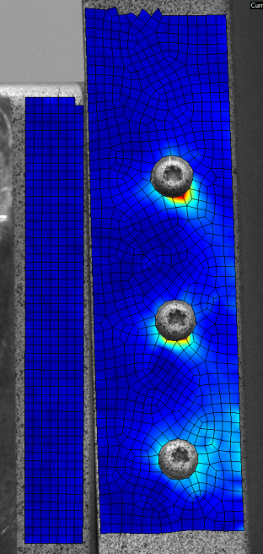
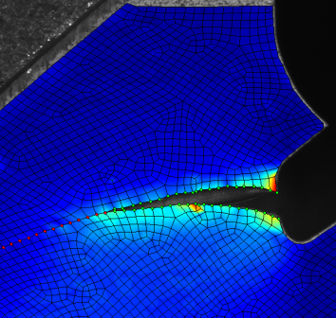
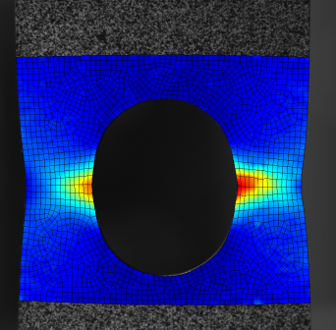
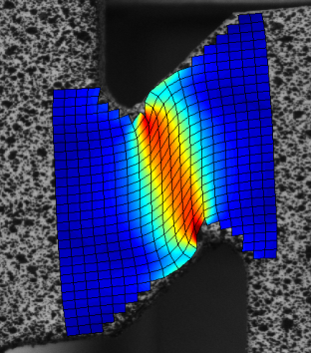
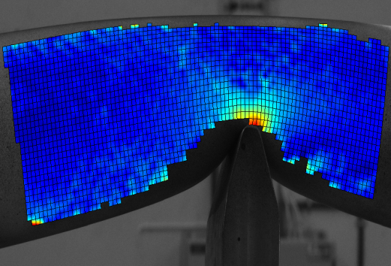
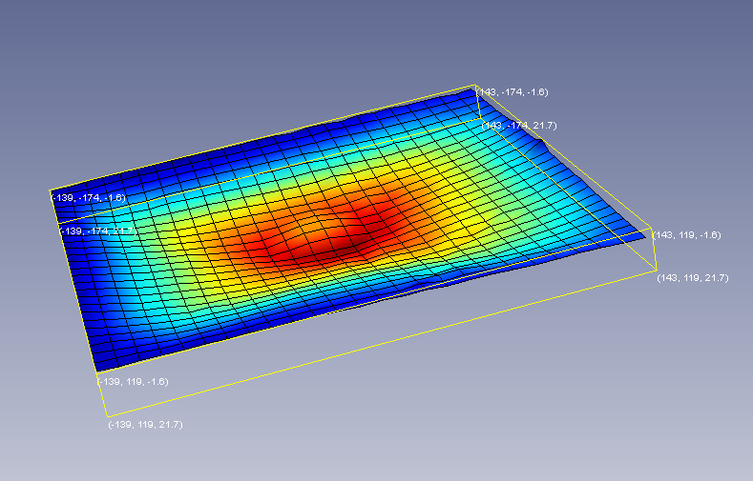
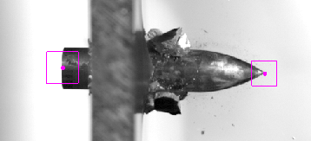
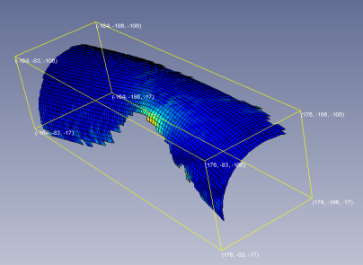
Range of applications Examples
Material tests
Component Tests
Crack propagation
Pipeline Impact
Blast loading of plates
Point Tracking

Slide 9
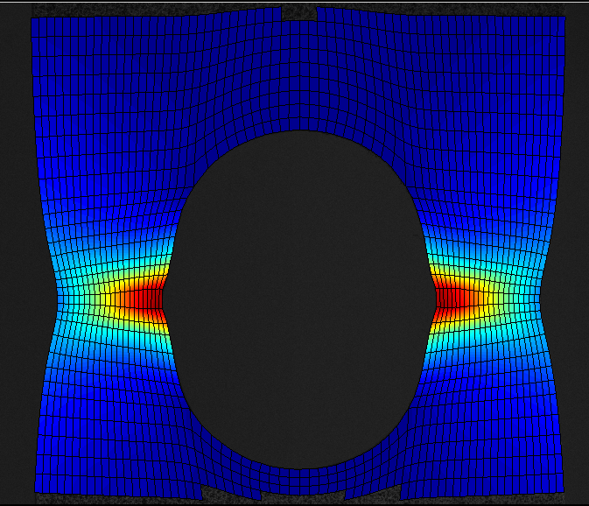
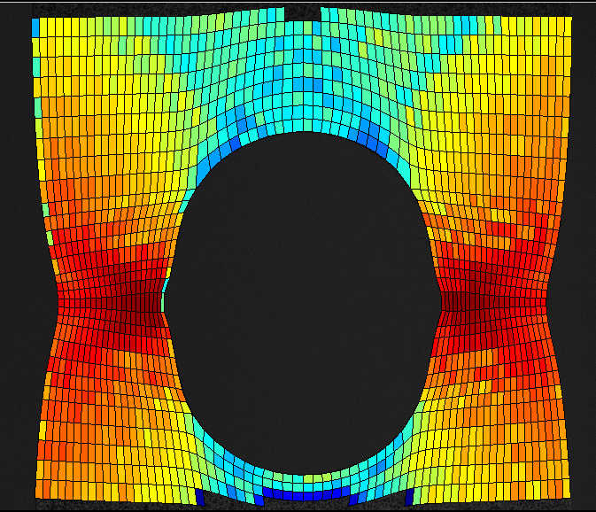
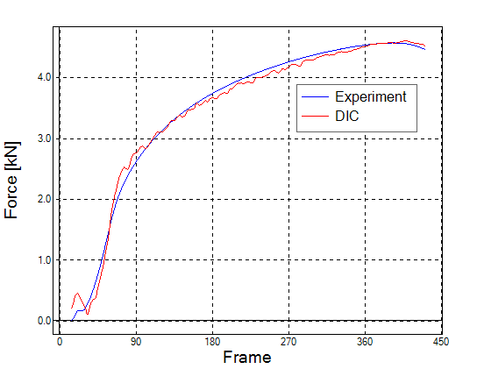
Material model validation DIC-FEM coupling
Strains measured by DIC
Calculated stress fields
Material model parameters
Material
model
Cross section
Computed force
from DIC and material
model
Experimental force
from load cell

Slide 10
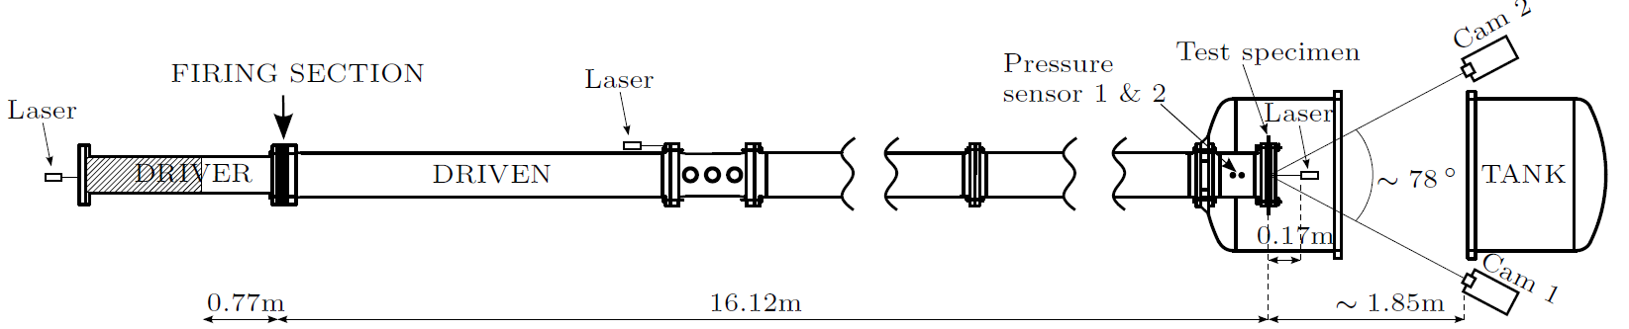
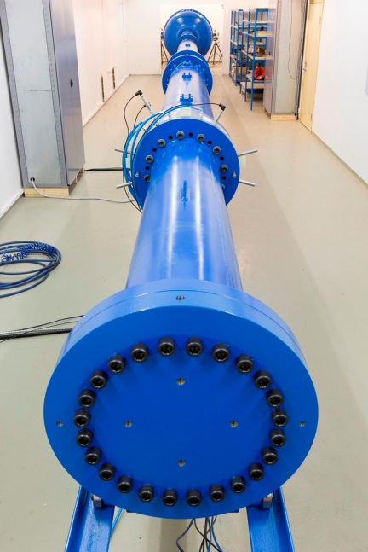
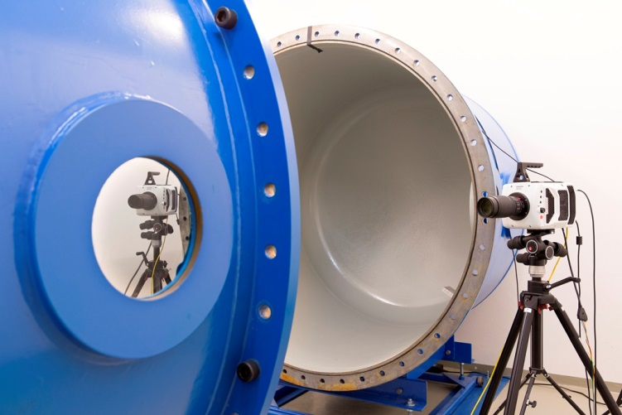
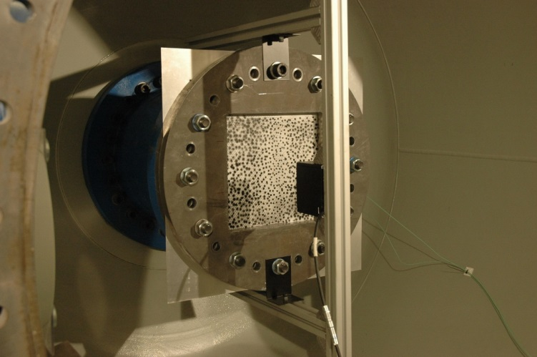
Validation of 3D-DIC SIMLab Shocktube

Slide 11
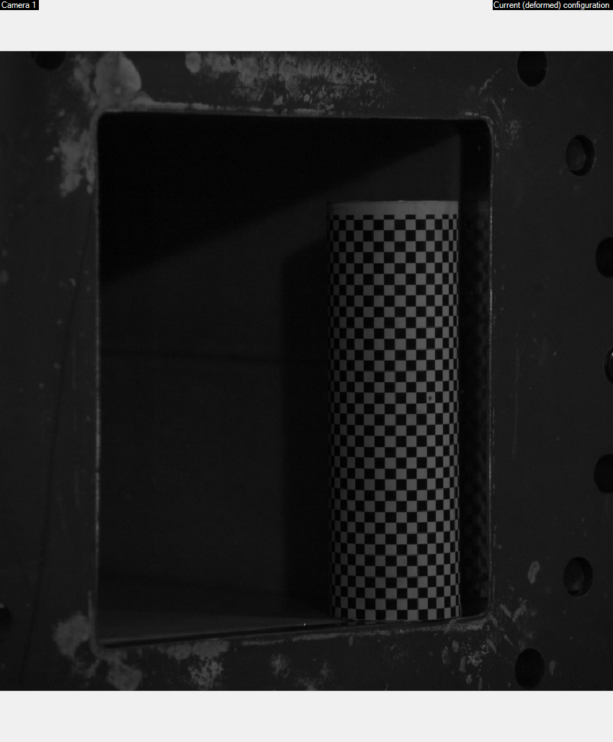
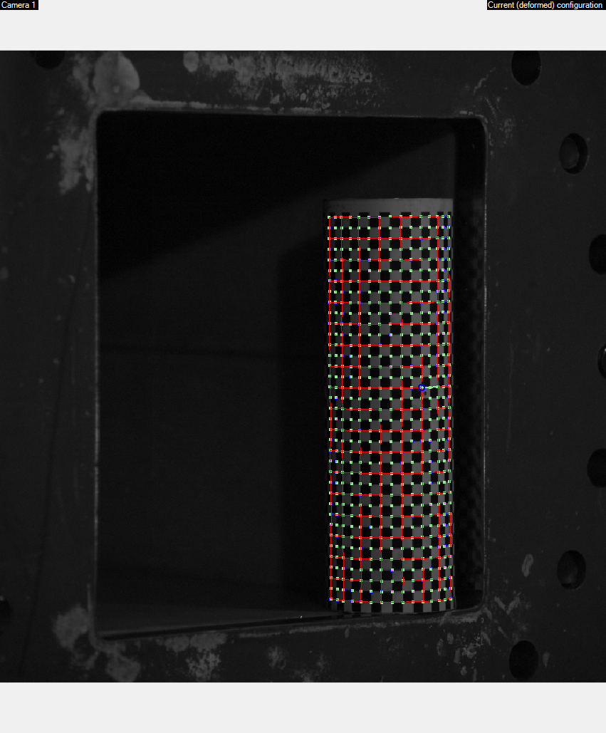
Validation of 3D-DIC Camera Calibration

Slide 12
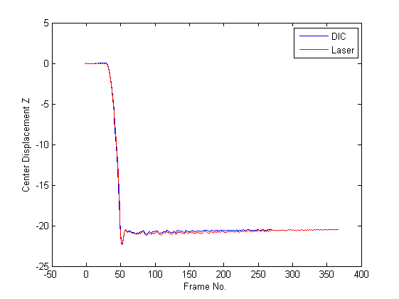
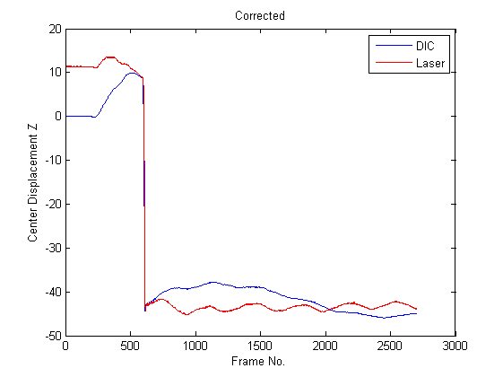
Validation of 3D-DIC Initial Results
Aluminium
0.8 mm
2.5 bar
Steel
0.8mm
75 bar
Avvik ~ 1/100 mm

Slide 13
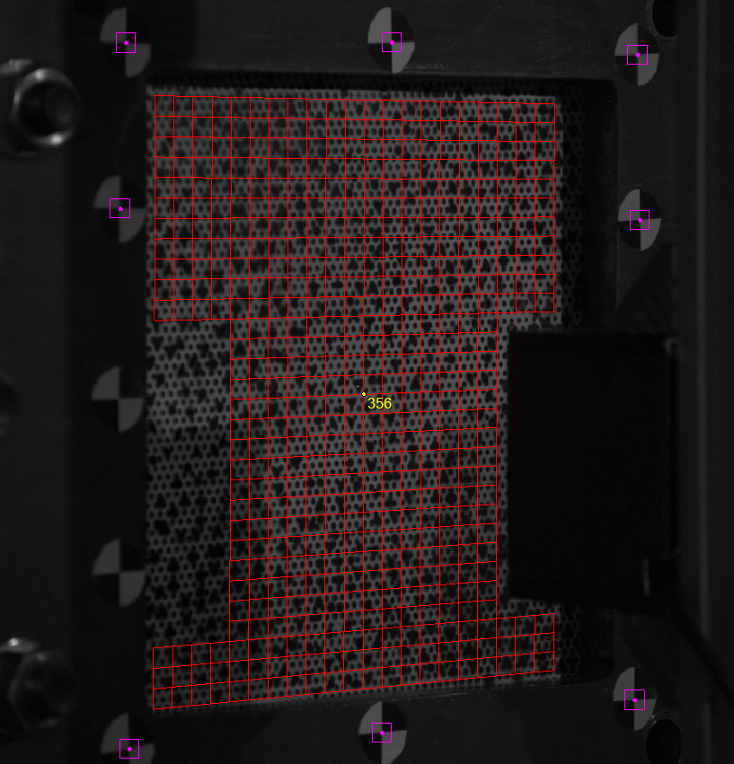
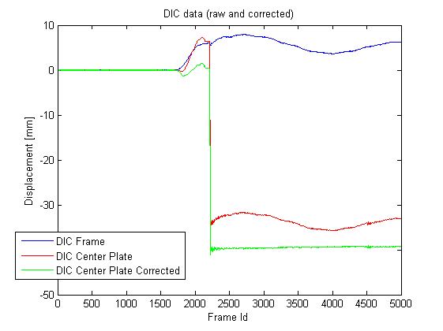
Validation of 3D-DIC Frame tracking
Steel
0.8mm
40 bar

Slide 14
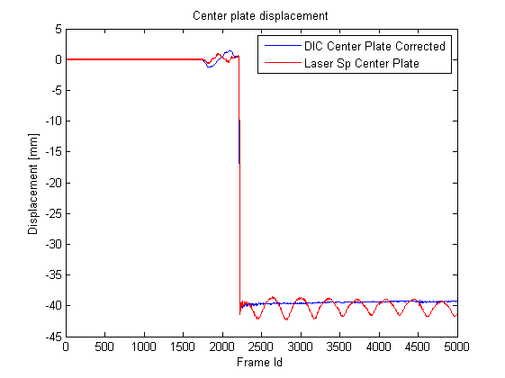
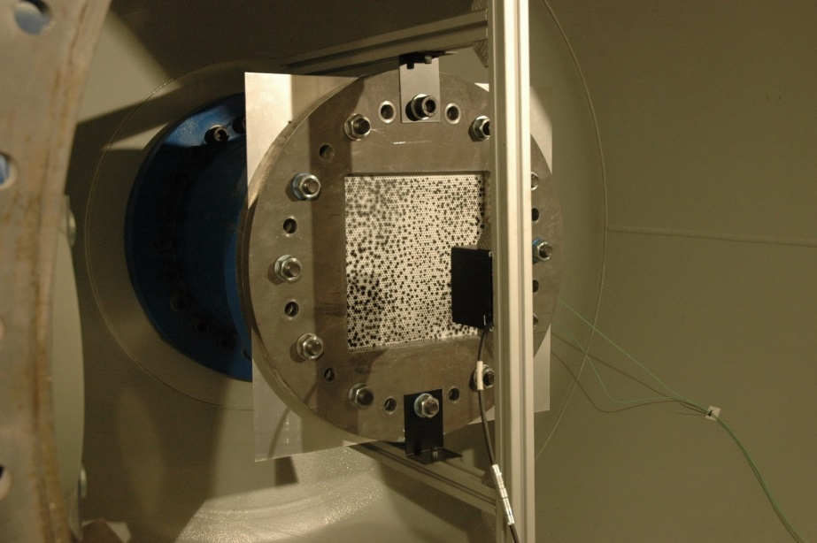
Validation of 3D-DIC

Slide 15
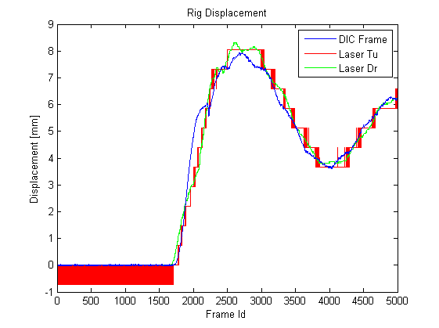
Validation of 3D-DIC

